Slide 1


Generative AI
Full Stack Developer
01

Slide 2
Course A : Prompt Engineering
05

Slide 3
01
Introduction to Machine Learning & Generative AI
05

Slide 4
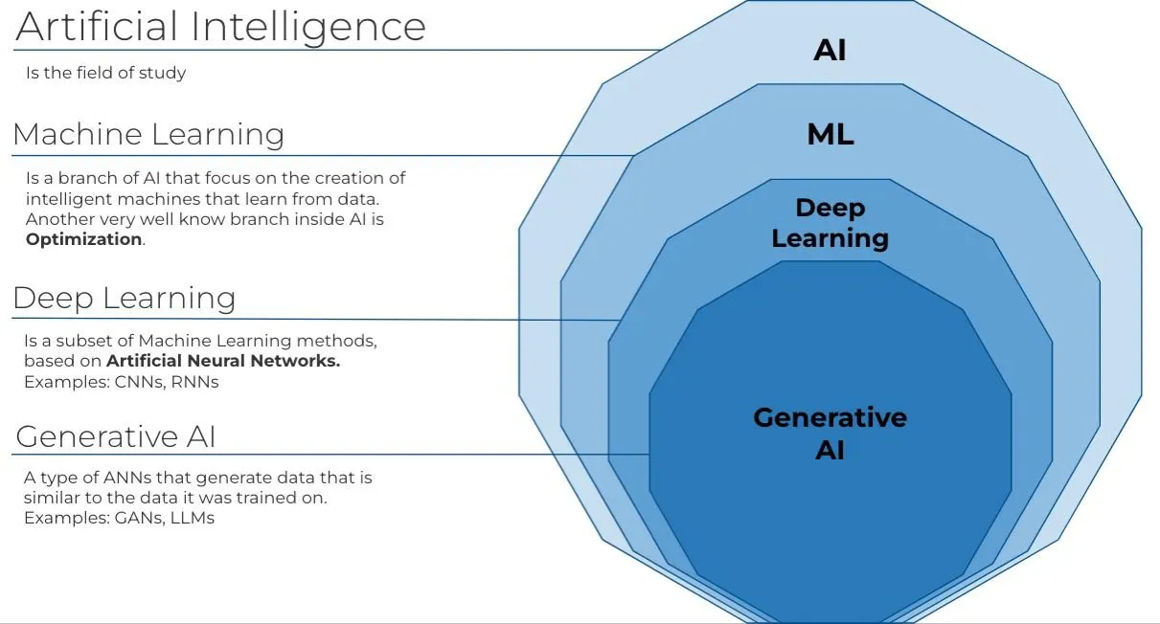
What is Generative AI - Gen AI

Slide 5
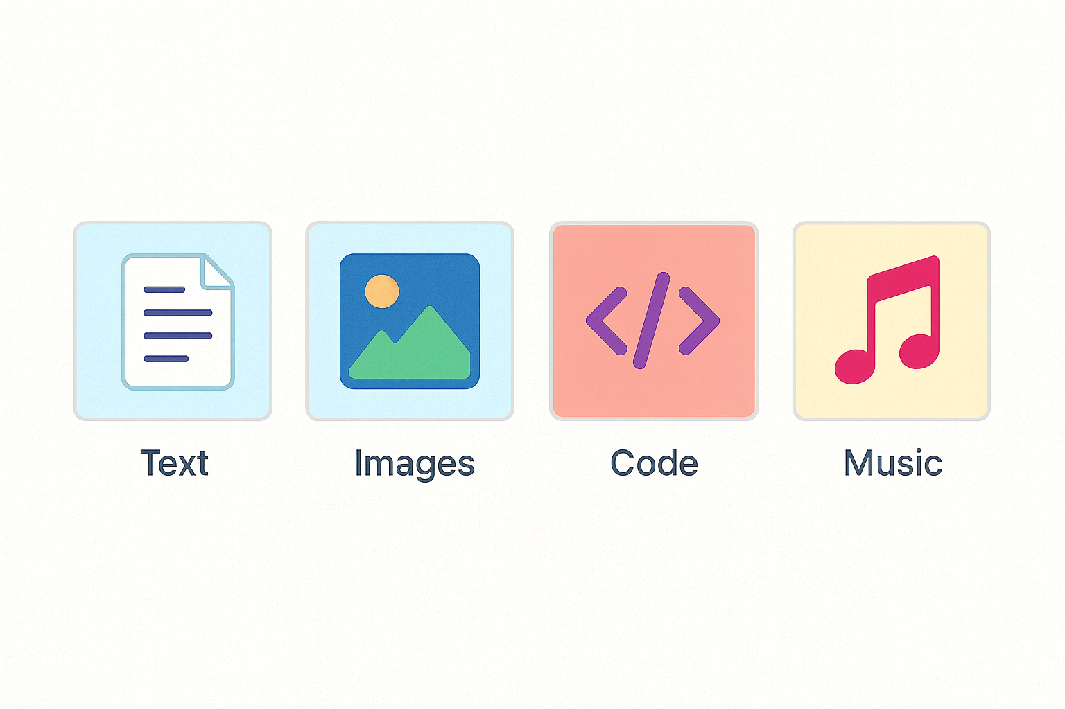
What is Generative AI - Gen AI
Subset of ML that creates novel data: text, images, code, music
Unlike traditional ML that classifies or predicts, Generative AI produces entirely new content
Learns joint data distribution; samples new instances that fit it
Models capture patterns and relationships across all data dimensions

Slide 6
How Generative Models Work?
Train on large corpora ⇒ model internalises patterns
Models learn statistical relationships and underlying structure from massive datasets.
Sampling/decoding strategies: temperature, top-k, nucleus
Control creativity vs. consistency when generating new outputs.
Key architectures: GANs, VAEs, Transformers
Different approaches with specialized strengths for various generation tasks.

Slide 7
Popular Generative Architectures
Architecture | Key idea | Typical usE
GAN | Generator vs. Discriminator duel | Photorealistic images
VAE | Probabilistic encoder/decoder | Anomaly detection, molecules
Transformer | Self-attention over sequences | Chat GPT-style LLMs
Each architecture represents a different approach to generating novel content, with unique strengths in specific domains and applications

Slide 8





Gen AI Applications Across Industries
Marketing
Copy & image generation for ads, personalized campaigns
Finance
Synthetic data for stress tests, fraud detection, risk modeling.
Pharma
Protein or drug discovery, molecular structure simulation.
Manufacturing
design optimisation, predictive maintenance, process efficiency.
Media & Gaming
Virtual characters, voice dubbing, procedural game content.
07

Slide 9
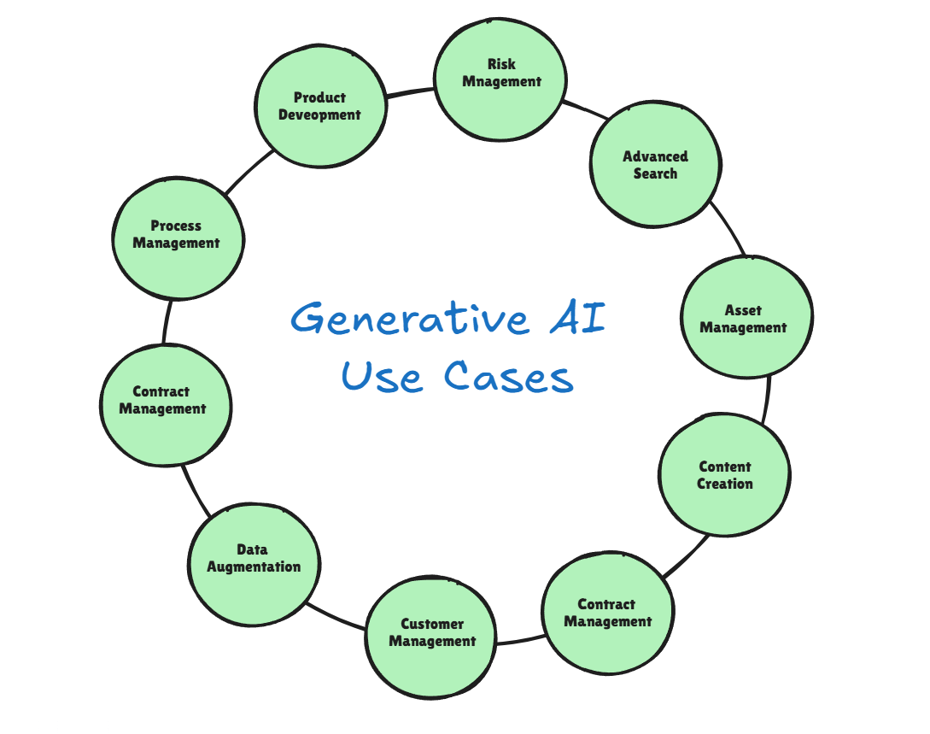
Gen AI Use cases

Slide 10






Advantages of Gen AI
Creativity amplifier & rapid prototyping
Fills data gaps with high-quality synthetic examples
Accelerates ideation and creation processes, enabling quick
iteration of concepts and designs.
Generates realistic training data for edge cases and
underrepresented scenarios,
Personalised user experiences at scale
Delivers customized content and interactions for individual
Users without manual intervention.

Slide 11
Disadvantages & Limitations
Challenge | Impact
"Hallucinations" | Incorrect or fabricated facts
Bias amplification | Reinforces societal inequities
IP & copyright risk | Training data may contain protected IP
Compute & energy cost | Large carbon footprint
Understanding these limitations is crucial for responsible implementation and developing effective mitigation strategies

Slide 12
Ethical Considerations
Fairness & non-discrimination:
Audit training data, apply bias-mitigation techniques to prevent perpetuating stereotypes or disadvantaging certain groups
Transparency:
Explain model scope and limitations to users, ensuring they understand how the model works and its potential shortcomings
Accountability:
Retain human oversight for high-stakes decisions where algorithmic failures could lead to significant harm

Slide 13
Key Takeaways
ML predicts; Generative AI creates
Understanding this fundamental distinction guides effective utilization
Mastering the ML pipeline clarifies where prompt engineering fits
Context helps you become more effective at steering AI systems
Benefits are huge, but responsibility is non-negotiable
Ethical considerations must accompany technical implementation

Slide 14
Q / A

Slide 15
Thanks

